Slide 1
Week 12: CRUD

Slide 2
Agenda
Questions?
Potential Git Workflow
Additional Resources
Next Week: React

Slide 3
Using Git with Branches

Slide 4
Potential Git Workflow
Clone the repository to your computer: git clone https://your-repository.git
Create a branch for the feature you’re going to add (and name it after that feature): git checkout -b my-branch-name
Write your code!
At any time you can check the status of your branch: git status
While you’re working on it, add and commit frequently whenever you get a piece working: git add . git commit -m “Added something”
Optional: You can push your branch to the online repository if you want it backed up: git push origin my-branch-name
When you’re completely finished with that feature, merge it back into the main branch: git checkout main git pull origin main git merge my-branch-name
If you have any merge conflicts, you’ll need to go to those files and fix them and then add and commit: git add . git commit -m “Merged feature in”
And push your newly merged code to the online repository git push

Slide 5
Online Repository
main
c1
c2
c3
Contributor 1’s Computer
Contributor 2’s Computer
main
main
c1
c2
c3
c1
c2
c3
git clone https://your-repository.git
git clone https://your-repository.git
Potential Git Workflow

Slide 6
Online Repository
main
c1
c2
c3
Contributor 1’s Computer
Contributor 2’s Computer
main
feature1
main
feature2
...
c3
...
c3
git checkout -b feature1
git checkout -b feature2
Potential Git Workflow

Slide 7
Online Repository
main
c1
c2
c3
Contributor 1’s Computer
Contributor 2’s Computer
main
feature1
main
feature2
...
c3
c4
c6
...
c3
c5
c7
git add . git commit -m “Added deleting” ...
git add . git commit -m “Added updating” ...
Potential Git Workflow

Slide 8
Online Repository
main
c1
c2
c3
Contributor 1’s Computer
Contributor 2’s Computer
main
feature1
main
feature2
...
c3
c4
c6
...
c3
c5
c7
git checkout main
Potential Git Workflow

Slide 9
Online Repository
main
c1
c2
c3
Contributor 1’s Computer
Contributor 2’s Computer
main
feature1
main
feature2
...
c3
c4
c6
...
c3
c5
c7
git pull
Potential Git Workflow

Slide 10
Online Repository
main
c1
c2
c3
Contributor 1’s Computer
Contributor 2’s Computer
main
feature1
main
feature2
...
c3
c4
c6
...
c3
c5
c7
git merge feature1
Potential Git Workflow

Slide 11
Online Repository
main
c1
c2
c3
c4
c6
Contributor 1’s Computer
Contributor 2’s Computer
main
feature1
main
feature2
...
c3
c4
c6
...
c3
c5
c7
git push
Potential Git Workflow

Slide 12
Online Repository
main
c1
c2
c3
c4
c6
Contributor 1’s Computer
Contributor 2’s Computer
main
feature1
main
feature2
...
c3
c4
c6
...
c3
c5
c7
git checkout main
Potential Git Workflow

Slide 13
Online Repository
main
c1
c2
c3
c4
c6
Contributor 1’s Computer
Contributor 2’s Computer
main
feature1
c4
c6
main
...
c3
c4
c6
...
c3
c5
c7
feature2
git pull
Potential Git Workflow

Slide 14
Online Repository
main
c1
c2
c3
c4
c6
Contributor 1’s Computer
Contributor 2’s Computer
main
feature1
c4
c6
main
c8
...
c3
c4
c6
c3
c5
c7
feature2
git merge feature2 git add . git commit -m “Merged feature2 into main”
Potential Git Workflow

Slide 15
Online Repository
main
c5
c7
c8
c1
c2
c3
c4
c6
Contributor 1’s Computer
Contributor 2’s Computer
main
feature1
c4
c6
main
c8
...
c3
c4
c6
c3
c5
c7
feature2
git push
Potential Git Workflow

Slide 16
AJAX with a REST API

Slide 17
API
Channels
Users
Posts
The Backend
index.html
index.css
bundle.js
picture.png
Single Page Application

Slide 18
API
Channels
Users
Posts
The Backend
index.html
index.css
index.html
bundle.js
picture.png
Single Page Application

Slide 19
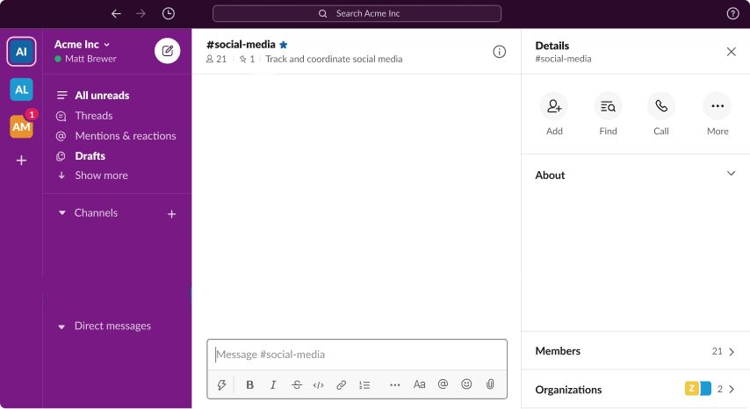
API
Channels
Users
Posts
The Backend
index.html
index.css
bundle.js
picture.png
Single Page Application

Slide 20
bundle.js
API
Channels
Users
Posts
The Backend
index.html
index.css
bundle.js
picture.png
Single Page Application

Slide 21
bundle.js
API
Channels
Users
Posts
The Backend
index.html
index.css
bundle.js
picture.png
Single Page Application

Slide 22
bundle.js
API
Channels
Users
Posts
The Backend
index.html
index.css
bundle.js
picture.png
Single Page Application

Slide 23
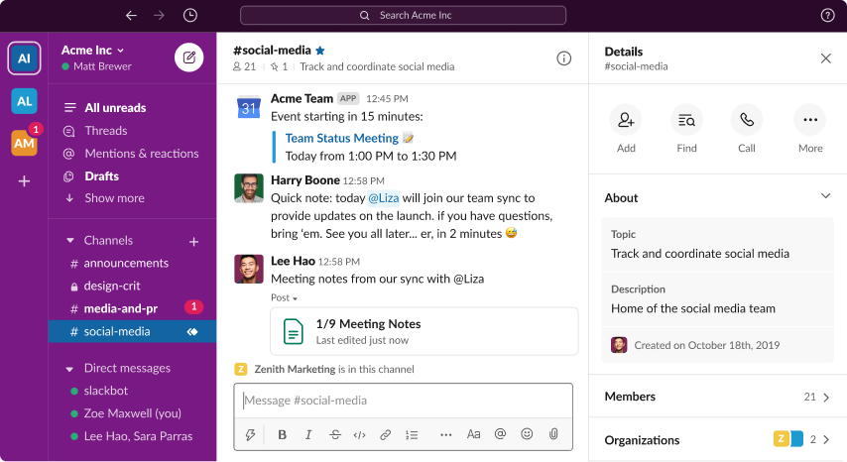
bundle.js
API
Channels
Users
Posts
The Backend
index.html
index.css
bundle.js
picture.png
Single Page Application

Slide 24
Simple Definitions
Asynchronous: code that can run in the background while other code is also running
HTTP: a way to communicate across the internet, used by browsers and fetch, short for Hypertext Transfer Protocol
API: a chunk of a backend that handles requests to get or change data, short for Application Programming Interface
REST: A very popular philosophy for how to build a backend API, short for Representational State Transfer
JSON: a syntax for data, based on Javascript’s objects and arrays, short for Javascript Object Notation
AJAX: a way to make a HTTP request (to an API) asynchronously with Javascript, short for Asynchronous Javascript and XML (which is a dumb name because nobody uses XML anymore, we use JSON)
CORS: communicating with a backend at a different location on the internet, short for Cross-Origin Resource Sharing

Slide 25
Metaphor
Instead of making an Asynchronous HTTP request using AJAX to a REST API that accepts CORS requests and getting a response with JSON...
You’re multitasking by texting under the table to your mom (respectfully) in another state and she sends you internet slang back because she’s cool like that. Disclaimer: It’s not a perfect metaphor, but I still like it
Asynchronous = multitasking
HTTP = texting
API = your mom
REST = how you should talk to your mom
JSON: internet slang
AJAX: texting under the table
CORS: talking to someone in another state

Slide 26
REST & Fetch
Endpoint: “http://something.com/api/unicorns”
Action | Method | Fetch
Create | POST | fetch("http://something.com/api/unicorns", { method: “POST”, headers: { "Content-Type": "application/json" }, body: JSON.stringify(unicornToCreate) })
Read | GET | fetch("http://something.com/api/unicorns") fetch("http://something.com/api/unicorns/1234")
Update | PUT | fetch("http://something.com/api/unicorns/1234", { method: "PUT", headers: { "Content-Type": "application/json" }, body: JSON.stringify(updatedUnicornData) })
Delete | DELETE | fetch("http://something.com/api/unicorns/1234", { method: "DELETE" })

Slide 27
Async & Await
Await
Tells Javascript you want to wait for the function to fully finish and give the result, not a Promise
Oversimplified:
await = I’ll wait
Example:
const response = await fetchData()
Async
Tells Javascript this function takes a long time and you probably don’t want to wait for the result
Oversimplified:
aync = It’s gonna to be a awhile
Example:
const fetchData = async () => { // returned value is put in a Promise }

Slide 28
Steps of Working with Fetch
1. Make the request and get a response. You’ll need to give fetch the right parameters for the type of request you’re making.
const response = await fetch(‘whatever’)
2. Optional: Handle any errors. You can check the response to see if the server had an issue. You can also wrap everything in a try-catch to handle if there’s an issue sending the request (like lost internet).
if(!response.ok) { // handle that it didn’t work }
3. Optional: Parse the data from the response. Not all responses will have data. For example, the response from a delete request often doesn’t have any data. Sometimes the response has data but you don’t need it, and then you wouldn’t need to parse it. Once you parse the data, you may need to get certain properties on it or process it.
const data = await response.json()

Slide 29
Additional
Resources
Git and Github Workflow for Beginners
https://www.codingmadeclear.com/git-github-workflow-for-beginners/
Git and Github Cheatsheet for Beginners
https://www.codingmadeclear.com/git-github-cheat-sheet-for-beginners/
Git: The Simple Guide
https://rogerdudler.github.io/git-guide/
Git & Github for Beginners
https://www.youtube.com/watch?v=SWYqp7iY_Tc
Merging a Branch Into Main
https://stackabuse.com/git-merge-branch-into-master

